Slide 1
I/O Tags
Siemens
© 2014 John Sefcovic.

Slide 2
I/O Tags
All I/O connections are PLC Tags.
Each I/O PLC Tag address should be given a Name.
Recommended practice and a common accepted practice.
A name assigned to a data entry to make it more convenient to locate or manipulate.
The use of an Alias:
Organizing the I/O data to mirror the machinery or process.
Documents the I/O in the application as it is developed.

Slide 3
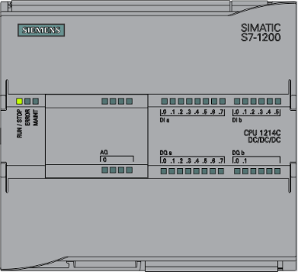
I/O Tags
Data sent to the PLC are Inputs and are “read” by the PLC.
Data originating at the PLC are Outputs and are “written” by the PLC.

Slide 4
I/O Tags
The rungs of logic are named Network. Usually there is one rung per network, but multiple rungs can be in a Network.
The Hardware I/O is designated with the following letter prefixes:
I
Q
for Input
for Output
Examples:
The % indicates the data is Global, data at the controller scope.
%I0.1 or %Q0.3
PLC Tags are used to name the data used in the logic.
Example:
%I0.1
“switch”

Slide 5
I/O Tags
The addressing format for Inputs and Output connections is:
operand type byte.bit
operand | I for input; Q for output.
type | Data format; Boolean for I/O and omitted from address
byte | Byte associated with I/O termination data
bit | Bit associated with I/O terminations

Slide 6
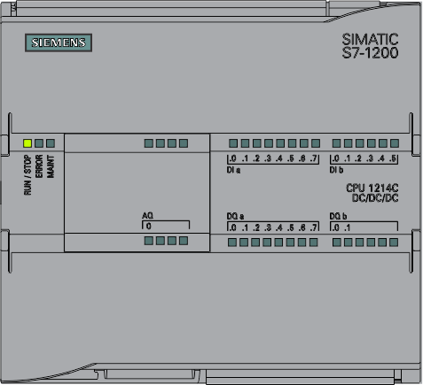
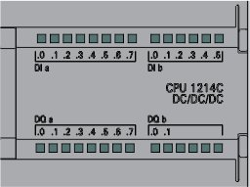
I/O Tags
S7-1200
Digital Inputs - 14
Digital Outputs - 10
The bytes is 8 bits of data, each bit is associated with a termination.

Slide 7
I/O Tags
S7-1200
Digital Inputs - 14
Digital Outputs - 10
The byte is 8 bits of data, each bit is associated with a termination.
The format for inputs is %(Scope) I (Operand) 0 (Byte) .num (Bit).

Slide 8
I/O Tags
S7-1200
Digital Inputs - 14
Digital Outputs - 10
The built-in inputs at Byte 0.
The format for inputs is %(Scope) I (Operand) 0 (Byte) .num (Bit).

Slide 9
I/O Tags
S7-1200
Digital Inputs - 14
Digital Outputs - 10
The built-in inputs at Byte 0 and Byte 1.
The format for inputs is %(Scope) I (Operand) 1 (Byte) .num (Bit).

Slide 10
I/O Tags
S7-1200
Digital Inputs - 14
Digital Outputs - 10
Example: %I0.0, first termination
The format for inputs is %(Scope) I (Operand) 0 (Byte) .num (Bit).

Slide 11
I/O Tags
S7-1200
Digital Inputs - 14
Digital Outputs - 10
Example: %I0.1
The format for inputs is %(Scope) I (Operand) 0 (Byte) .num (Bit).

Slide 12
I/O Tags
S7-1200
Digital Inputs - 14
Digital Outputs - 10
Example: %I0.7
The format for inputs is %(Scope) I (Operand) 0 (Byte) .num (Bit).

Slide 13
I/O Tags
S7-1200
Digital Inputs - 14
Digital Outputs - 10
Example: %I1.0, next Byte
The format for inputs is %(Scope) I (Operand) 1 (Byte) .num (Bit).

Slide 14
I/O Tags
S7-1200
Digital Inputs - 14
Digital Outputs - 10
Example: %I1.5, last termination, 14
The format for inputs is %(Scope) I (Operand) 1 (Byte) .num (Bit).

Slide 15
I/O Tags
S7-1200
Digital Inputs - 14
Digital Outputs - 10
The built-in outputs at Byte 0.
The format for inputs is %(Scope) Q (Operand) 0 (Byte) .num (Bit).

Slide 16
I/O Tags
S7-1200
Digital Inputs - 14
Digital Outputs - 10
The built-in outputs at Byte 0 and Byte 1.
The format for inputs is %(Scope) Q (Operand) 1 (Byte) .num (Bit).

Slide 17
I/O Tags
S7-1200
Digital Inputs - 14
Digital Outputs - 10
Example: %Q0.0, first termination
The format for inputs is %(Scope) Q (Operand) 0 (Byte) .num (Bit).

Slide 18
I/O Tags
S7-1200
Digital Inputs - 14
Digital Outputs - 10
Example: %Q0.1
The format for inputs is %(Scope) Q (Operand) 0 (Byte) .num (Bit).

Slide 19
I/O Tags
S7-1200
Digital Inputs - 14
Digital Outputs - 10
Example: %Q0.7
The format for inputs is %(Scope) Q (Operand) 0 (Byte) .num (Bit).

Slide 20
I/O Tags
S7-1200
Digital Inputs - 14
Digital Outputs - 10
Example: %Q1.0, next Byte
The format for inputs is %(Scope) Q (Operand) 1 (Byte) .num (Bit).

Slide 21
I/O Tags
S7-1200
Digital Inputs - 14
Digital Outputs - 10
Example: %Q1.1, last termination, 10
The format for inputs is %(Scope) Q (Operand) 1 (Byte) .num (Bit).

Slide 22
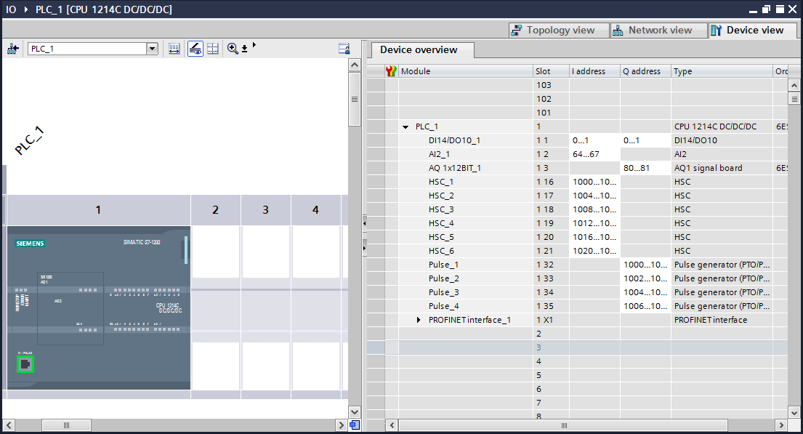
I/O Tags
In the Project Tree, expand PLC_1 and double left click on Device configuration to open this dialog window.
In the Device view dialog, the byte assignments can be viewed.

Slide 23
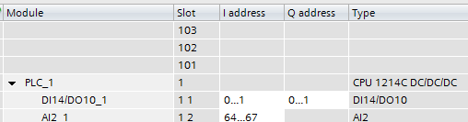
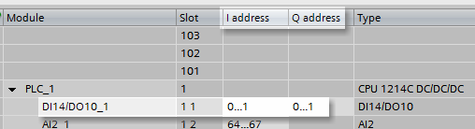
I/O Tags
S7-1200
Digital Inputs - 14
Digital Outputs - 10
The Inputs and Outputs each require two Bytes, 0 and 1, for the number of terminations.

Slide 24
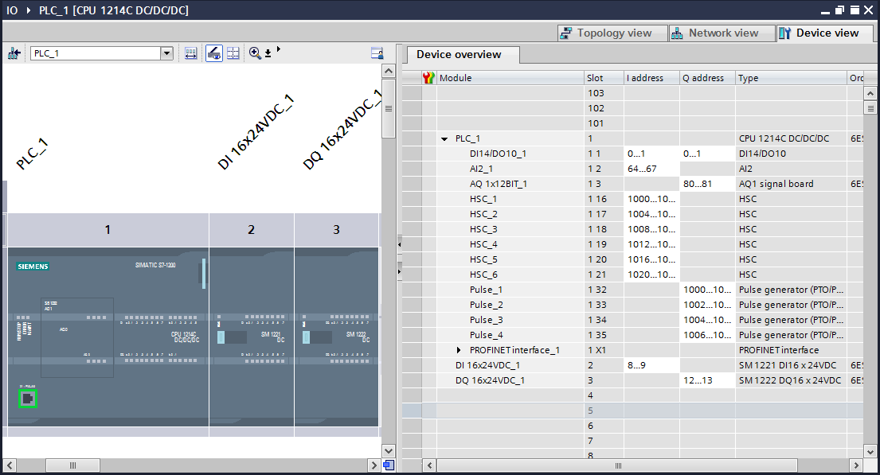
I/O Tags
In this example a Digital Input module (16 points)

Slide 25
I/O Tags
In this example a Digital Input module (16 points) and Digital Output (16 point) module are added.

Slide 26
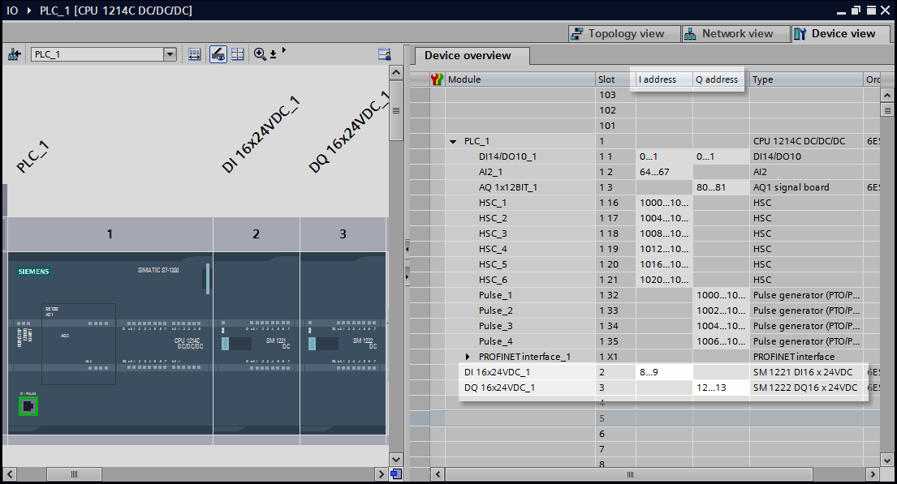
I/O Tags
Notice the assigned Bytes are not sequential , the system will put a gap of two bytes or more between Bytes assignments.

Slide 27
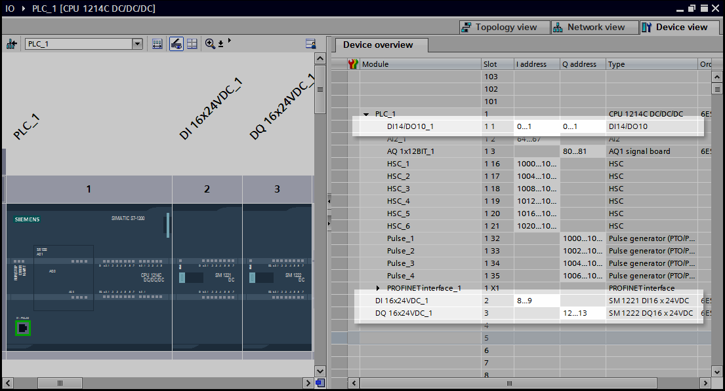
I/O Tags
Note: Slot 1 Subslot 1 is the internal slot of the built-in I/O of the PLC
Always check Device view to verify Byte assignment to the physical I/O Slot location.

Slide 28
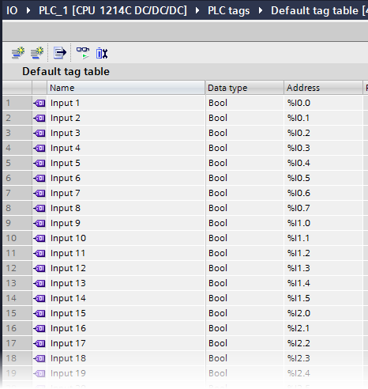
I/O Tags
The Bit addresses are always 0 to 7.
Note: This is the user entered PLC Tag table, there is no built-in dialog to view the Bit addresses.

Slide 29
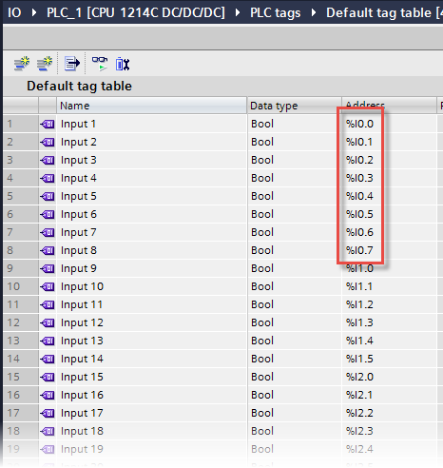


I/O Tags
The Byte 0 with Bit addresses 0 to 7.
Built-in PLC Inputs, Slot 1 (Internal Slot 11).

Slide 30
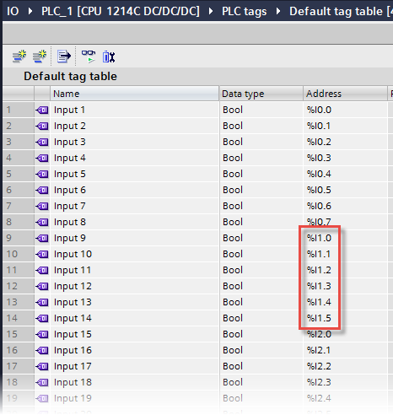
I/O Tags
The Byte 1 with Bit addresses 0 to 5.
Built-in PLC Inputs, Slot 1 (Internal Slot 11).

Slide 31
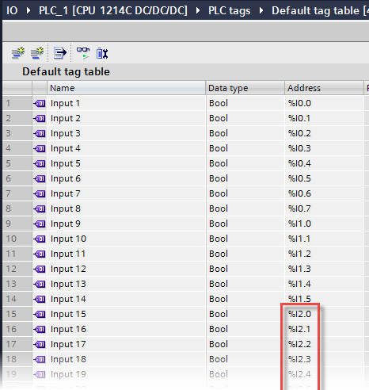

I/O Tags
The Byte 2 with Bit addresses starting at 0.
Added Input Module, Slot 2.
The Input Module has 16 points.
Byte 2 - %I2.0 to %I2.7
Byte 3 - %I3.0 to %I3.7

Slide 32
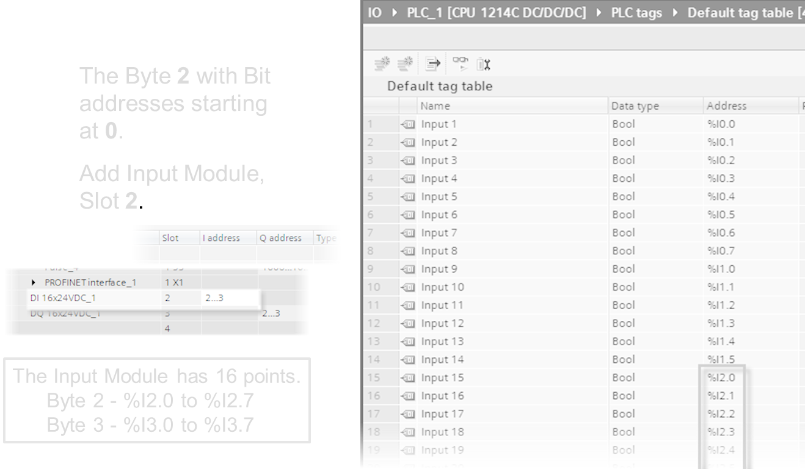
I/O Tags
The Outputs addresses are similar to the Inputs.
Byte - assigned to the slot
Bit - 0 to 7
Note: For Input and Output slots, a 16 point will use 2 Bytes and an 8 point 1 Byte.
Slots greater than 8 points but less than 16 points, ie. 14 points, will use 2 Bytes.

